Slide 1
Evolution / phylogeny session:
introduction
Mark A. Ragan
Institute for Molecular Bioscience
The University of Queensland
Brisbane, Australia
and
Australian Research Council (ARC)
Centre in Bioinformatics
ISMB 2004 / ECCB 2004, Glasgow, 2 August 2004
© Mark Ragan 2004

Slide 2
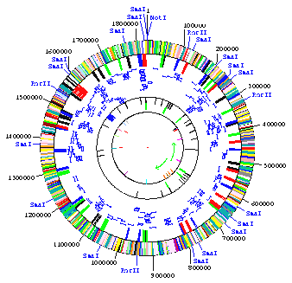
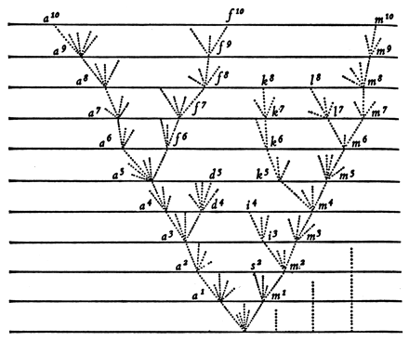
To a first (and often quite good) approximation, gene families have arisen by descent with modification via a hierarchy of increasingly distant common ancestors
time
Genomes: TIGR
Tree: Darwin, Origin of Species
© Mark Ragan 2004

Slide 3
By applying statistical methods, we can attempt to reconstruct this history
Why? To understand…
Evolutionary patterns and processes
Relationships among gene families, genomes & organisms
Relationships among structure, function & evolution
Evolution of biosynthetic and signalling pathways, regulatory systems & genomes
© Mark Ragan 2004

Slide 4
AAA superfamily
mei-1 Caenorhabditis
Meiosis/Mitochondria
0.1
sATPase Schistosoma
C24B5.2 Caenorhabditis
M03C11.5 Caenorhabditis
YTA6
SAP1 YEN7
MSP1 YTA4
YME1 YTA11 OSD1
END13
K04D7.2 Caenorhabditis
ftsH Mycoplasma genitalium
SKD1 Mouse
DM19DC4Z Drosophila
Metalloproteases
ftsH Mycoplasma pneumoniae
Spsup S.pombe
A2126A Mycobacterium *
ftsH Helicobacter
SEC18
sll1463 Synechocystis
SEC18 Candida
Secretion/
CAPFTF Capsicum
NSF Tobacco
YCF25 Porphyra
NSF Hamster/SKD2 Mouse
slr1390 Synechocystis
NSF Man
slr0228 Synechocystis
NSF Caenorhabditis
Neurotransmission
ATPASE Capsicum
NSF Drosophila
ftsH Arabidopsis
NSF2 Drosophila
slr1604 Synechocystis
YCF25 Odontella
ftsH Bacillus
K04G2.3 Caenorhabditis *
ftsH tma Lactococcus
ftsH Haemophilus
CEC11H1.6 Caenorhabditis
ftsH hflB E.coli
PAS1 Man
YTA12 RCA1
PAS1
YTA10 AFG3
PAS1 Pichia
Peroxisomes
YHEA Methanobacterium *
PAF2 Rat
PAF-2 Man
S8 Methanococcus *
PAS8
PAS5 Pichia
CHRXII new
PAY4 Yarrowia
smallminded Drosophila
YTA7
F11A10.1 Caenorhabditis
Subunits of the 26S proteasome
cdcH Halobacterium
CDC48 Methanococcus
YTA1
SAV Sulfolobus
TBP1 Rat
C41C4.8 Caenorhabditis
TBP-1 Man
C06A1.1 Caenorhabditis
Sata Rat
VCP Pig/TER-ATPase Rat
TBP1 Rice
VCP Mouse
LeMA-1 Tomato
Cell Division Cycle/
p97 Xenopus
26S Spinacia
CDC48
YTA3 CIM5
AtCDC Arabidopsis
C52E4.4 Caenorhabditis
CAFP Capsicum
MSS1 Mouse
Centrosome/
sVCP Glycine
MSS1 Rat
cdcD Dictyostelium
MSS1 Man/Xenopus
S7
CDCATP Plasmodium
TBP Plasmodium
ER Homotypic Fusion
AFG2 DRG1
TBP Naegleria
TBP10 Dictyostelium
CADp44 Squirrel
S
4
Methano
coccus
18-56 Manduca
p42 Man
Trip1 Man
SUG2
SUG1 Xenopus
mts2 S.pombe
mSUG1 Mouse/SUG1 Rat/TBP10 Pig
YTA5 YHS4
POTATP1 Solanum
SUG1 CIM3
S8
S4 Chicken
TBP-2 Dictyostelium
Let1 S.pombe
P26S4 Mouse/S4 Rat/S4 Man
cATPase Caenorhabditis
S4
P26S4 Drosophila
MS73 Manduca
TBP
α
TBP2 Rice
TBP7 S6 Man/TBP7 Rat
Kai-Uwe Fröhlich
http://aaa-proteins.uni-graz.at/AAA/Tree.html
Dictyostelium
CIP21 Mouse
S6
tbpA Aspergillus
YTA2 YNT1
© Mark Ragan 2004

Slide 5
Why infer trees? (cont.)
Within individual families, trees allow us to draw inferences about historical relationships.
These inferences guide our thinking about the living world, and support rational decision-making about e.g. the quantitation and protection of genetic diversity
© Mark Ragan 2004

Slide 6
Homology (common ancestry)
is the basis of phylogenetics
(indeed, of all non-anecdotal biology)
Any homologous character can, in principle, serve as the basis for phylogenetic analysis, including gene and protein sequences, RNA or protein folded structure, gene content or order, pathway or network topology, cellular ultrastructure, physiology, morphology etc.
PAPER 32
© Mark Ragan 2004

Slide 7
Gene and protein sequences have an obvious genetic basis, are information-rich, and are relatively straightforward to analyse
Almost all methods of phylogenetic inference currently require that we formulate a hypothesis of homology position-by-position along the molecule, such that only homologous nucleotides, codons or amino acids are compared
© Mark Ragan 2004

Slide 8
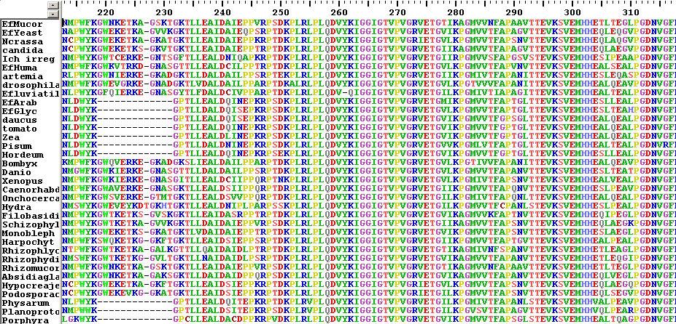
A multiple sequence alignment is a position-by-position hypothesis of homology
Data from Ragan et al., Mol. Phylog. Evol. 29: 550-562 (2003)
© Mark Ragan 2004

Slide 9
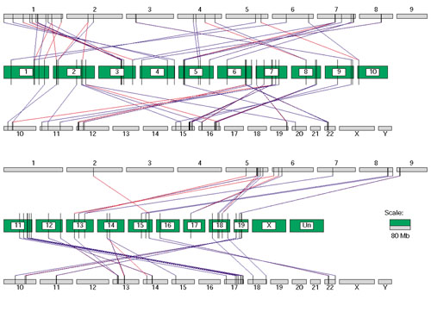
Homology can become obscured
Potentially obscuring processes include sequence evolution, gene loss, gene fusion and fission, recombination, and lateral gene transfer
Xuan, Wang & Zhang, Genome Biology 2002, 4:R1, Figure 5
© Mark Ragan 2004

Slide 10
If the input sequences have undergone rearrangement or hybridisation relative to each other, most approaches require that we identify and untangle that before inferring a tree.
Alternatively, we may have to examine evolutionarily coherent modules, not entire genes. These might or might not correspond with structural modules (e.g. domains).
PAPER 34
© Mark Ragan 2004

Slide 11
Tree inference without optimisation
Background assumptions
(E.g., all trees are equiprobable)
Input data
(Arranged as a positional hypothesis of homology)
Matrix of pairwise distances
(Distances typically corrected for superimposed substitutions)
Tree-building algorithm
(E.g. neighbor-joining)
Tree (a hypothesis of phylogenetic relationships)
© Mark Ragan 2004

Slide 12
Distance (non-optimising) methods
Need not be biologically motivated
Can work in artificial, even purpose-built, frames of reference with any well-behaved distance metric
May (or may not) be interesting algorithmically, but unlikely to have biological relevance
© Mark Ragan 2004

Slide 13
Tree inference with optimisation
Background assumptions
(E.g., all trees are equiprobable)
Input data
(Arranged as a positional hypothesis of homology)
Quantitative model
(E.g., interconversion rates of nucleotides or amino acids)
Cost function
(E.g. likelihood function)
Optimisation algorithm
(E.g. branch & bound, or simulated annealing)
Acceptance criterion
(E.g. The most-likely tree I cound find, given resources and patience)
Tree (a hypothesis of phylogenetic relationships)
© Mark Ragan 2004

Slide 14
Quantitative model of sequence change
Change from one nucleotide (or dinucleotide, codon, amino acid etc.) to another as a function of time (or time surrogate)
The model can be as complicated as you wish (and as the data and biology allow)
For example, the nature and rate of change can be allowed to differ at different positions along the molecule, from one branch of the tree to another, through time, etc. Sites can be considered to be interdependent.
PAPER 38
PAPER 36
© Mark Ragan 2004

Slide 15
The “HKY” model of nucleotide change (Hasegawa, Kishino & Yano 1985)
A C G T
A - π_{C}β π_{G}α π_{T}β
C π_{A}β ₋ π_{G}β π_{T}α
G π_{A}α π_{C}β ₋ π_{T}β
T π_{A}β π_{C}α π_{G}β ₋
Where π_{X} is the frequency of base X, α is the rate of transitions, and β is the rate of transversions
The rates can be determined theoretically or empirically, or estimated from the input data.
© Mark Ragan 2004

Slide 16
The cost function is typically a measure of likelihood, or a count of inferred changes
The cost of a candidate tree is assessed computationally
Cost is a function of both topology and branch length
If the cost function is computationally demanding, assessing the cost of a candidate tree can be slow
PAPER 30
© Mark Ragan 2004

Slide 17
Optimisation in tree space
To optimise, alternative trees are proposed, and the cost of each is assessed.
Interestingly large problems have astronomically large search spaces; optimisation must be based on a heuristic.
Depending on the cost function, the best tree is the most-likely, most-parsimonious, etc.
Some methods may yield multiple best trees, or estimate the distribution of best trees.
© Mark Ragan 2004

Slide 18
Phylogenetic inference can be messy and involves tradeoffs and compromises (like science itself !)
We’re learning to make inferences about 3000+ million years of the most complex adaptive system on the planet … LIFE
Not all pieces “fit” yet (indeed, we probably don’t even know all the pieces yet)
Problems & conflicts may point to new biology
© Mark Ragan 2004

Slide 19
Five papers this afternoon:
30. Woodhams & Hendy Faster likelihood cost function
32. Dopazo et al. Exon presence/absence characters
in testing alternative hypotheses
34. Kummerfeld et al. Rates of gene fission & gene fusion
36. Lunter & Hein New context-dependent nucleotide
substitution model
38. Makova & Taylor Transitions at CpG dinucleotides
© Mark Ragan 2004

